Slide 1
MESH VPN
A private network
across the planet.
Deployment — minutes.
Virtual mesh networks at OSI Layer 3. Connect servers, data centers and offices into a single secure, high-speed network — with routing by traffic destination and management from the SPA Dashboard.
< 1 ms
L3
N × N
overhead
OSI layer
connectivity
Notes:
Mesh VPN is part of the Waitrex Systems product line.

Slide 2
THE PROBLEM
Where the corporate network stops working
01
02
03
The connection is detected by DPI
Deployment turns into a project
Changes require an engineer
WireGuard and IPsec have a fixed connection-setup signature. On filtered networks the tunnel never comes up — the rule is written against a constant marker.
Classic solutions require a separate fleet of servers, supporting software and months of integrator work.
Rules are stored in configuration files on the nodes. Changing a route for a single branch takes a dedicated specialist.
Mesh VPN closes all three with a single product.

Slide 3
TECHNOLOGY
What the organization gets
Routing at the OS kernel level
An O(1) routing table in the Linux kernel. Route lookup for a packet takes nanoseconds and does not depend on the number of rules.
OSI Layer 3, overhead under 1 ms
The tunnel operates at the network layer. Application traffic is neither inspected nor proxied — the only delay is the network path to the nearest node.
Full-mesh topology
Every node is connected to every other. Traffic travels between sites directly, without a central gateway: no single point of failure and no bandwidth bottleneck.
Transport without a permanent signature
A proprietary UDP protocol. Its parameters are unique to each installation, so a DPI rule would have to be written against your network specifically.

Slide 4
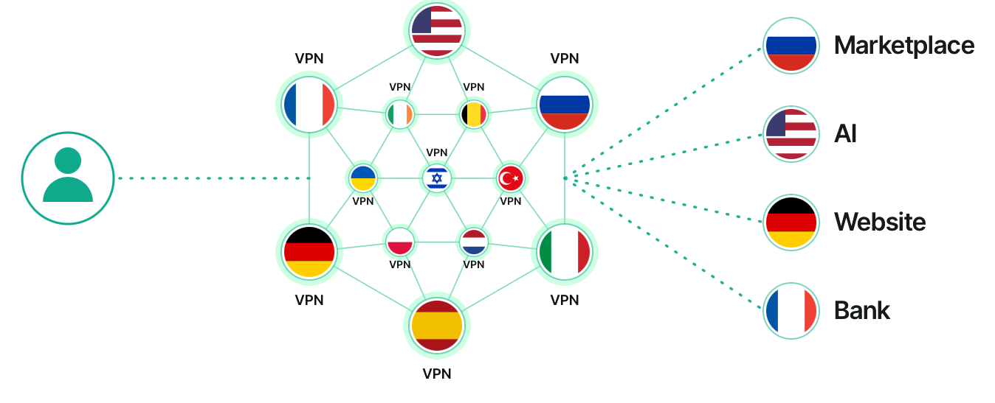
HOW IT WORKS
Every resource receives traffic from the right country
An employee connects once, to the nearest node. From there the marketplace sees a request from Russia, the bank from France, external services from the United States. Simultaneously, with no manual switching.

Slide 5
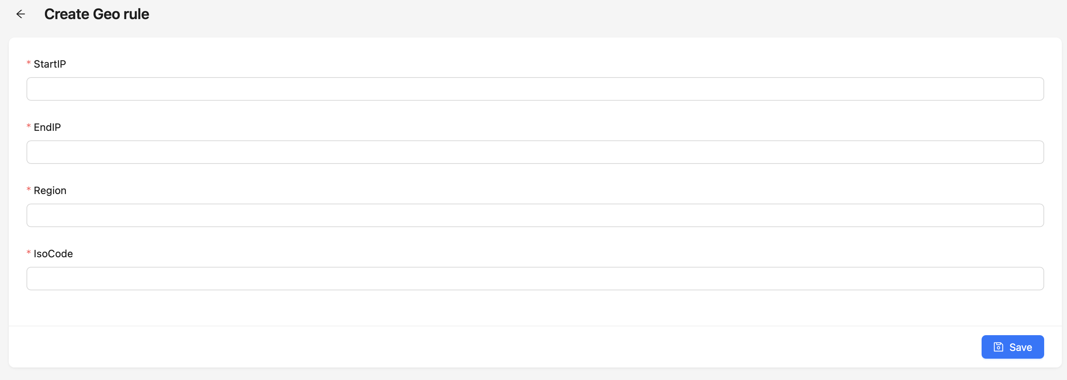
KEY CAPABILITY
A route is defined by a single rule
IP range, ISO country code, exit node — and save.
01
Ready to work immediately
Rules ship pre-populated. Routing works from day one.
02
Manual override
Any range can be directed to a chosen node on top of the base values.
Enter an IP — traffic goes through the right node.
03
Applied instantly
Rules ship out of the box and can be edited for your needs.
The rule reaches the kernel table immediately. Sessions are not dropped.
Routing geography is set by the administrator — in a browser, in seconds.
Notes:
The key demo slide. Creating a rule live takes seconds.

Slide 6
ENGINEERING SPECIFICATIONS
Performance and deployment requirements
ns
O(1)
< 1 ms
From 10 MB
Route lookup
Complexity
Overhead
RAM per node
An O(1) table in the Linux kernel. The per-packet decision takes nanoseconds.
Speed does not degrade as the rule count grows. A thousand rules perform like one.
Everything the solution adds to a connection. In practice — only the network path to the node.
Depending on the number of rules. Up to 4 GB when every IP on the planet is loaded (shipped out of the box).
Delivered as an executable file or a ready-made image. Resource requirements depend only on the number of rules — no dedicated hardware needed.

Slide 7
MANAGEMENT
SPA Dashboard: the network is configured by an administrator
All network objects are created and modified in the browser. Changes take effect instantly.
Routes
Exceptions
Rules by destination: subnet, domain, service. Each is bound to its own exit node.
What stays outside the tunnel: internal resources, payment systems, local subnets.
Servers
Devices
Network nodes. Deployment, shutdown and country binding — from the interface.
Employee computers and servers. A separate routing profile per device or group.
Notes:
In the demo: creating a country route in 30 seconds.

Slide 8
COMPARISON
How it differs from Tailscale
 | TAILSCALE | WAITREX
Transport | WireGuard — a fixed connection signature | Proprietary UDP, parameters unique to each installation
Networks with DPI | Detected by a basic rule, the tunnel never comes up | No permanent signature
Exit node | Chosen manually, one per device | Determined automatically by traffic destination
Management | ACL policy file and console on the nodes | SPA Dashboard, rules per range
Load distribution | One exit node per device — traffic concentrates, a separate balancer is required | Distributed by rules: the more rules, the more evenly spread across nodes
Hosting | SaaS coordinator; self-hosted only via third-party Headscale | Entirely within your own perimeter
Notes:
Comparison with Tailscale, the best-known WireGuard-based mesh solution. Based on their public documentation.

Slide 9
APPLICATION
Public sector and companies
Full control
over the perimeter
Operation on networks
with DPI
Sites
in different countries
Services tied
to a jurisdiction
Everything is deployed inside the organization. Keys, nodes and traffic never leave the perimeter; no third-party operator is involved.
Reliable connectivity where standard corporate tunnels fail to come up: branches, business trips, contractors.
Direct connectivity between offices and data centers over the ordinary internet, without leasing dedicated lines.
Access to resources that only work from a specific country: banks, payment systems, government portals.

Slide 10
USE CASES
Three industries, three tasks
IP telephony
Video surveillance
Branch network
The problem
The problem
The problem
Branches are wired in a star: RTP between two branches travels to the central node and back. Extra RTT and double bandwidth use at the hub. Plus SIP behind NAT — the ALG on the CPE breaks registration.
Site access is done through port forwarding — RTSP and ONVIF are exposed to the internet. The alternative is the vendor P2P cloud, which sends video to a third party. Streams from every site converge on a single gateway.
Every location needs a VPN gateway: purchase, configuration, on-site maintenance. Links are leased separately. Point-of-sale, acquiring and back-office traffic share one channel with no separation.
How Mesh VPN solves it
How Mesh VPN solves it
How Mesh VPN solves it
Full mesh: RTP travels branch ↔ branch directly, with no detour through the hub. Layer 3 overlay addressing means no NAT in the path, so the ALG has nothing to break.
The site and the monitoring station are nodes of one network, so no ports are published. The stream goes from the site to the NVR directly and gateway bandwidth does not add up. Video never leaves the perimeter.
A node is a process on hardware you already run: Linux, Docker or Kubernetes. Routes and exceptions separate point-of-sale, acquiring and accounting traffic — the segmentation PCI DSS uses to reduce assessment scope.
The same mechanism in all three cases: direct node ↔ node connectivity instead of a star through a central gateway.

Slide 11
DEPLOYMENT
Deployment — minutes
01
Node deployment
A couple of clicks in the dashboard to add a new node — only a password or public key is needed. Executable, Docker image or Kubernetes. Existing infrastructure is left untouched.
02
Rule configuration
Routes, exceptions and exit nodes are set in the dashboard for the organization’s services and geography.
03
Device onboarding
Devices connect with a single tap in the app — via QR code, email or social logins.
04
Easy integration
A complete REST API for programmatic control of the whole system. Documented and extensible.
Platforms
Windows · macOS · Linux · iOS · Android · Android TV

Slide 12
CONTACTS
Mesh VPN
We will deploy on your infrastructure and configure it for your services and geography.
Email
Website
info@waitrex.io
waitrex.io
Waitrex Systems
IT infrastructure and DevSecOps solutions for business

